Slide 1
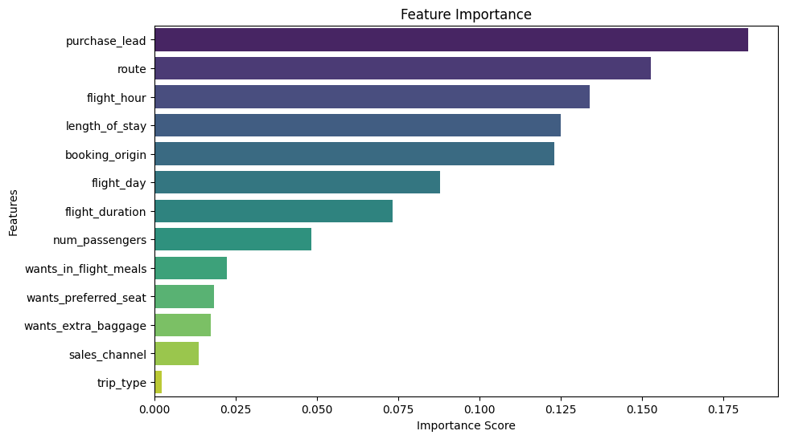
Result
Important Feature
Booked and Canceled Flight
Customer behavior shows that passenger who bought holiday ticket would consider the “route”, “flight hour”, and “booking origin”
15%
Customer choose to booked flight with BA Airways
85%
Customer choose to not flight with BA Airways

